Slide 1
PEBBLE "Bepo"
Awarded and protected product
Pupil cooperative „Rašeljka” – Elementary school „Josip Pupačić” Omiš, Croatia
Painting and sculpture section
Head of section : prof. Aleksandra Radunić

Slide 2
SOMETHING ABOUT THESE
Harmony singing is a traditional Croatian vocal music from Dalmatia.
It is sung in many voices, unaccompanied by musical instruments.
Harmony singing is extremely popular in Omiš with it’s annual festival. We just celebrated 50 years of this event. We created an original souvenir in honor of this tradition.

Slide 3
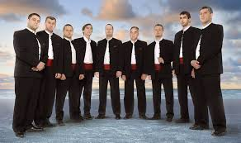
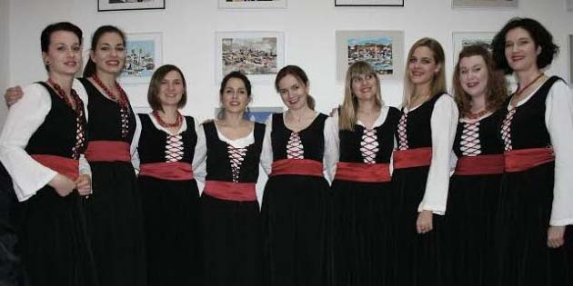
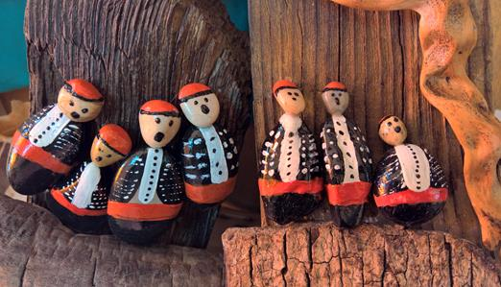
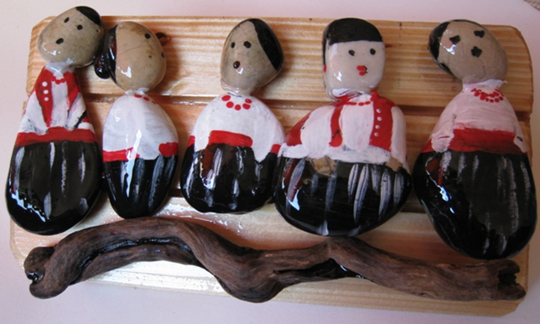
Final product type 1

Slide 4
Final product type 2

Slide 5
