Slide 1
THE STATUE OF LIBERTY

Slide 2
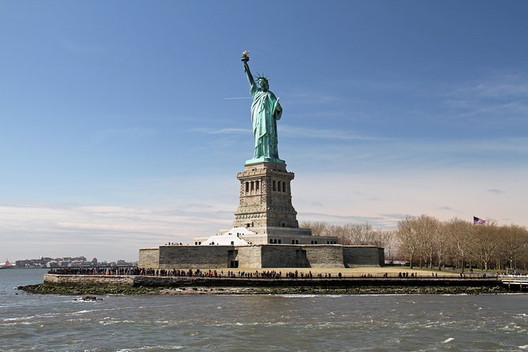
What is it?
It is a symbol of freedom.
It is a lady holding torch in her right hand and a tablet of laws in her left hand.
The lady wears a crown.

Slide 3
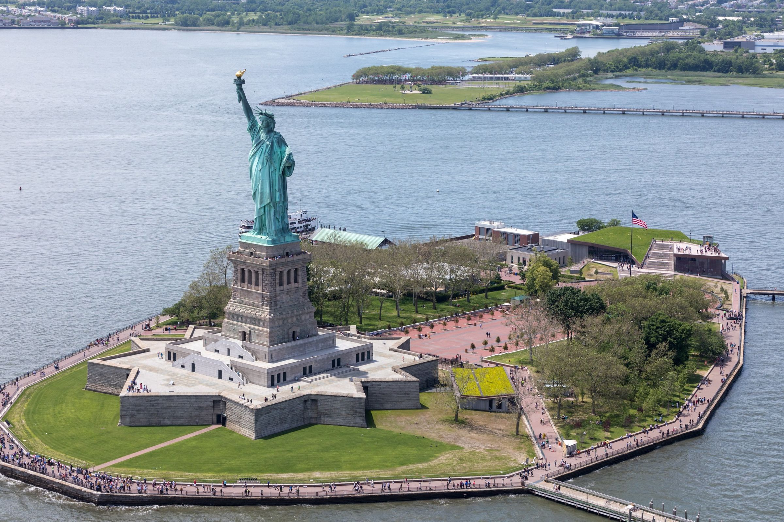
Where is it?
The Statue of Liberty is on Liberty Island in New York.
New York is in the United States.
Liberty Island is surrounded by the Hudson River.

Slide 4
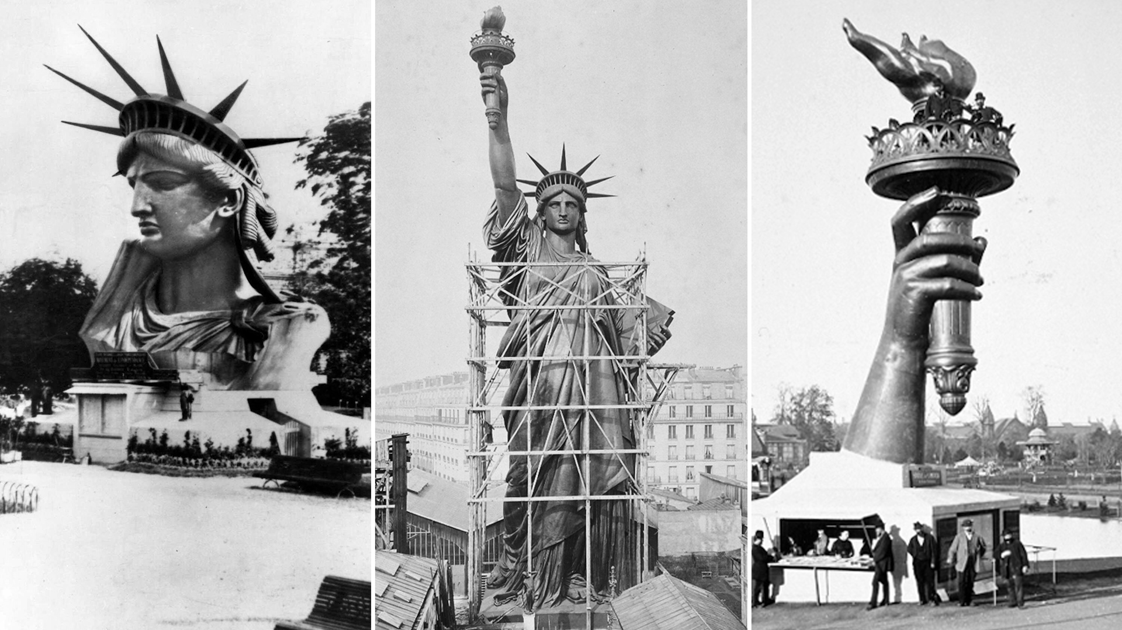
Where did the statue come from?
The statue was a gift from the people of France to the people of the United States.
It was designed by Frédéric Auguste and Gustave Eiffel.
It was divided into 350 pieces held in 214 crates during the shipment.

Slide 5
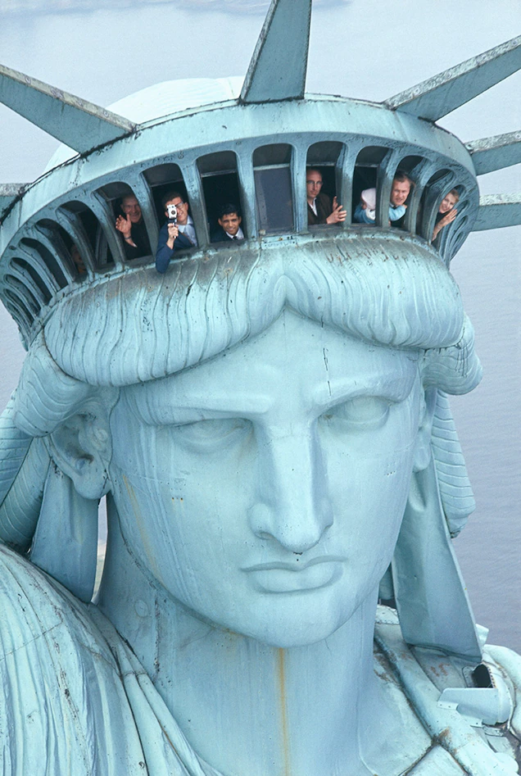
Interesting facts
From the ground to the top of the torch the statue measures 93 metres.
Visitors have to climb 354 stairs to reach the statue’s crown.
Lady Liberty wears a size 879 shoe.
In 1984 the statue was listed as a Unesco World Heritage Site.
The statue will be celebrating its 135th birthday on October 28, 2021.

Slide 6
Thank you for your attention!
Jakov Sovulj

