Slide 1
NYC CULINARY TOUR
MARIJA SOVULJ

Slide 2
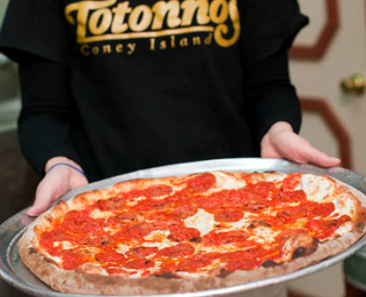
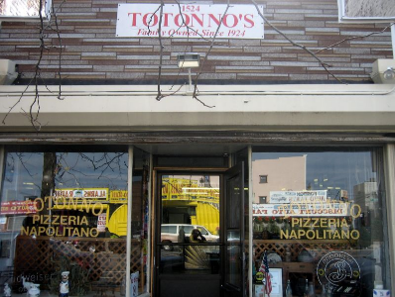
Pizza at Totonno's Pizzeria Napolitano
The Totonno's family has been making the best pizza in NYC for over 93 years.
Their philosophy is simple: as long as there's dough, they will bake us the best pizza, with the finest ingredients.
It is located at Coney Island.
The original location was damaged by fire in 2009, but reopened.

Slide 3
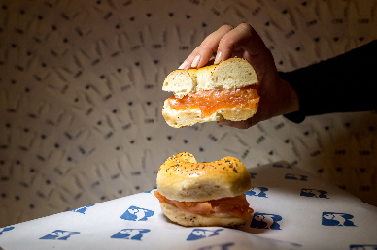
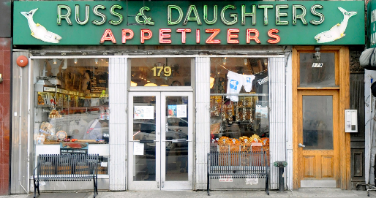
Bagel with lox and cream cheese at Russ & Daughters
It is an appetizing store located on the Lower East Side of Manhattan.
It has been at the same location since 1914.
The elements of The Classic at Russ & Daughters are bagel, salmon, cream cheese and assembly.
In 2021, the Financial Times ranked it as one of the “50 greatest food stores in the world.”

Slide 4
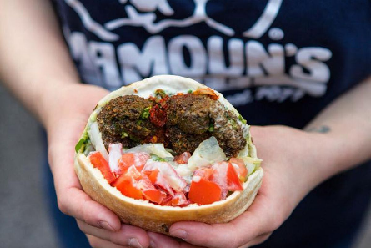
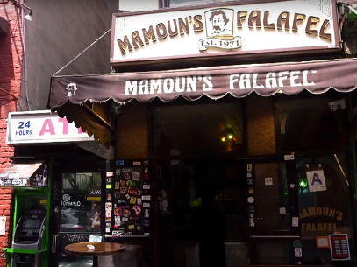
Falafel at Mamoun's
They’ve been around since 1971 - the longest Middle Eastern spot in all of New York.
It became a mega hit, first with NYU students and hippies, but soon with the general public.
Mamoun's falafel sandwiches are all vegetarian.

Slide 5
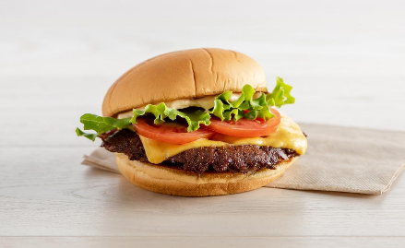
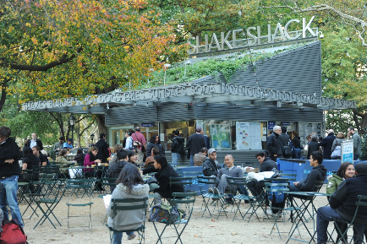
Shackburger at Shake Shack
Shake Shack is an American fast food chain based in New York City.
The Shackburger may have gone worldwide, but it was first flipped in Madison Square in 2004.
The secret to the Shackburger's popularity is the patty, which has beefy flavor, with lettuce and tomato and a mayo-based sauce.

Slide 6
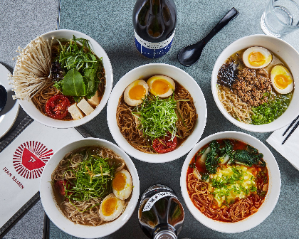
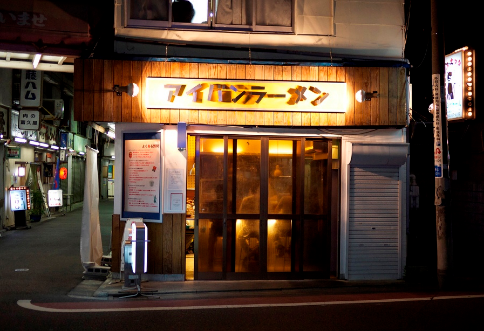
Ramen at Ivan Ramen
Ivan Orkin moved to New York in 2011, opening Ramen restaurants in Hell's Kitchen and the Lower East Side in 2013.
Ramen is a Japanese noodle soup. It includes dashi and chicken broth, minced pork, egg and rye noodles.

Slide 7
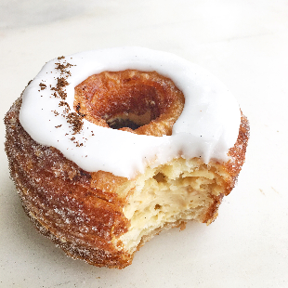
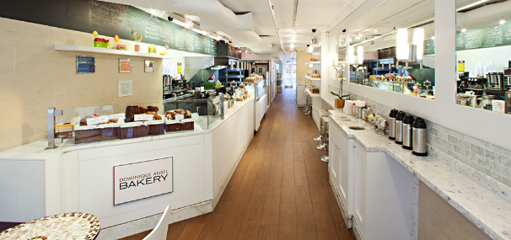
Cronut at Dominique Ansel Bakery
In 2013, bakery owner Dominique Ansel created the pastry out of dough similar to that of a croissant with flavored cream inside – The Cronut.
The bakery prepares a new flavor every month.

Slide 8
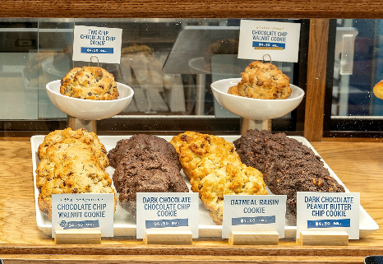
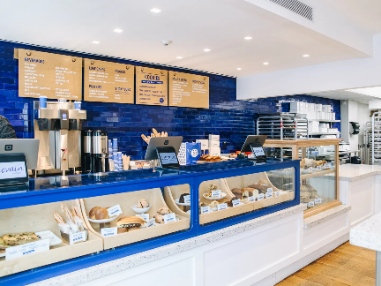
Chocolate chip walnut cookie at Levain Bakery
Constance McDonald and Pamela Weekes started out making bread in 1995, but ended up making cookies.
Levain offers four cookie flavors — dark chocolate chocolate chip, dark chocolate peanut butter chip, oatmeal raisin and chocolate chip walnut.
Each cookie costs $4.

Slide 9
Sources:
https://ny.eater.com/maps/new-york-city-iconic-dishes-restaurants
https://sharedappetite.com/eat/top-10-foods-eat-nyc/
https://www.totonnosconeyisland.com/
https://www.eater.com/2014/6/30/6201785/the-classic-bagel-and-salmon-sandwich-at-russ-daughters-in-new-york
https://www.insider.com/mamouns-most-legendary-falafel-nyc-2019-9
https://shakeshack.com/home
https://en.wikipedia.org/wiki/Cronut
https://www.timeout.com/newyork/restaurants/ivan-ramen

Slide 10
Thank you for your attention!

