Slide 1
NYC Movie and TV Sites’ Tour

Slide 2
NYC Movie Tour
At the best of times, life in New York can be disarmingly cinematic, whether you’re walking through the park (any park!) on a perfect fall day.
Jammed into a booth at a gorgeous old-style restaurant, or riding the Q train over the East River.
The hum and thrum of the city is filled with grace notes—which is why, for decades and decades.
Its boroughs have been a backdrop for some of film’s most hilarious, romantic, and deeply moving moments.
Whatever your go-to genre—musicals, thrillers, crime dramas, romantic comedies—here’s a roundup of movies to remind you why there’s simply no place like New York.
In the Heights
On the Rocks
Uptown Girls

Slide 3
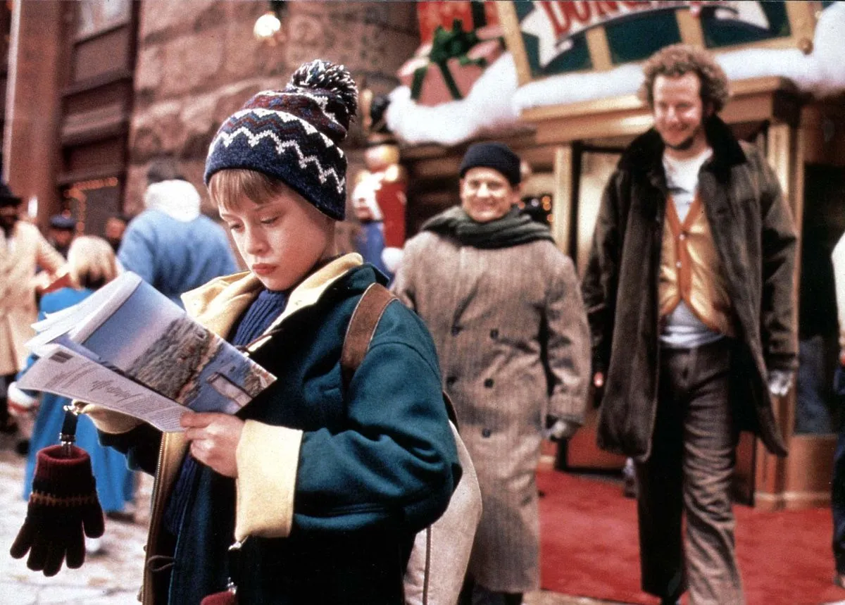
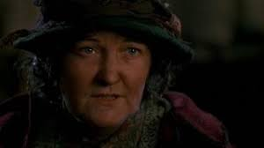
HOME ALONE(Sam u kući)
We experience this film more as a return to childhood, associating it with the smell of Christmas and the taste of cake.
But now we want to analyze it from a traveler’s perspective.
Of course, we mean the second film in the series, called "Lost in New York."
The panorama of the city will be offered to us right at the beginning, through the windows of the airport itself, but from there we move a little further.
On the TV screen you will see classics such as the Queensboro Bridge, the Statue of Liberty, the Plaza Hotel, Central Park, Times Square, Rockefeller Center, and you will even see the World Trade Center.

Slide 4
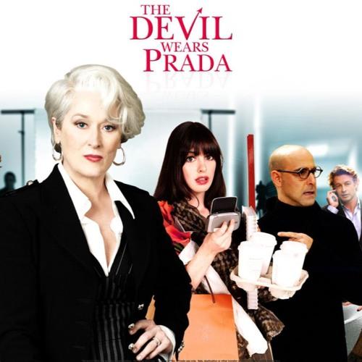
The devil wears Prada(Vrag nosi Pradu)
Fashion is an integral part of New York. But the fashion world is also about courage and experimentation.
So, bravely and no matter what you’re wearing, enter the world of Andree Sachs (Anne Hathaway) and Miranda Priestly (Meryl Streep)
We're leaving for New York. We stop in front of The St Regis near the Museum of Modern Art and six minutes from Central Park.

Slide 5
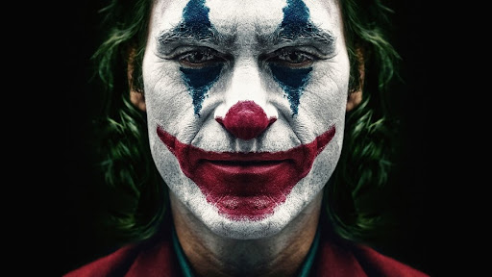
Joker
The stairs in the New York Bronx, which appeared in the successful film "Joker" (2019), have become a tourist attraction since the premiere of the film.
The residents of that neighborhood have to deal with a large influx of tourists who try to imitate the film scene or just take photos there.
Some even come in costumes to a place between two buildings on Shakespeare Avenue.
The story of bankrupt comedian Arthur Fleck takes place on a thin line between reality and madness.
One day, in his clown suit, Arthur wanders the streets of Gotham City, New York, and becomes embroiled in a confrontation with brutal thieves.
This irreversibly triggers a spiral of events that reach threatening proportions.
The abandoned Fleck falls into madness and gradually turns into a criminal, who the world knows as the Joker.

Slide 6
TV sites’ Tour
NYC news
Local news
Breaking news
Traffic
FOX
CBS
NYCTV life
…

Slide 7
NBC
NBC or the National Broadcasting Company is an American radio and television network owned by NBC Universal, a subsidiary of Comcast.
The company is headquartered in the Comcast Building, which is part of the Rockefeller Center in New York City, with important offices in Los Angeles, Chicago and Philadelphia.
It was established in 1926 as part of the RCA (Radio Corporation of America) and is the oldest network in the United States.

Slide 8
Fox
Fox Broadcasting Company is an American commercial free-to-air television network owned by Fox Corporation.
Launched as a competitor to Big Three television networks (ABC, CBS and NBC) on October 9, 1986.
It was the highest-rated free-to-air network in the 18- to 49-year-old demographic from 2004 to 2012 and 2020.
And became the most-watched U.S. television network in total viewership during the 2007-2008 season.
Fox and its affiliates operate many entertainment channels in international markets, but they do not necessarily broadcast the same program as the U.S. network.

Slide 9
Sources:
https://www.vogue.com/article/best-new-york-movies
https://peliputnik.hr/najbolji-filmovi-koji-se-odigravaju-u-new-yorku/
https://www.nme.com/blogs/the-movies-blog/home-alone-2-lost-new-york-facts-2168291
https://en.wikipedia.org/wiki/Fox_Broadcasting_Company
https://hr.wikipedia.org/wiki/NBC
https://www.nbcnews.com/

Slide 10
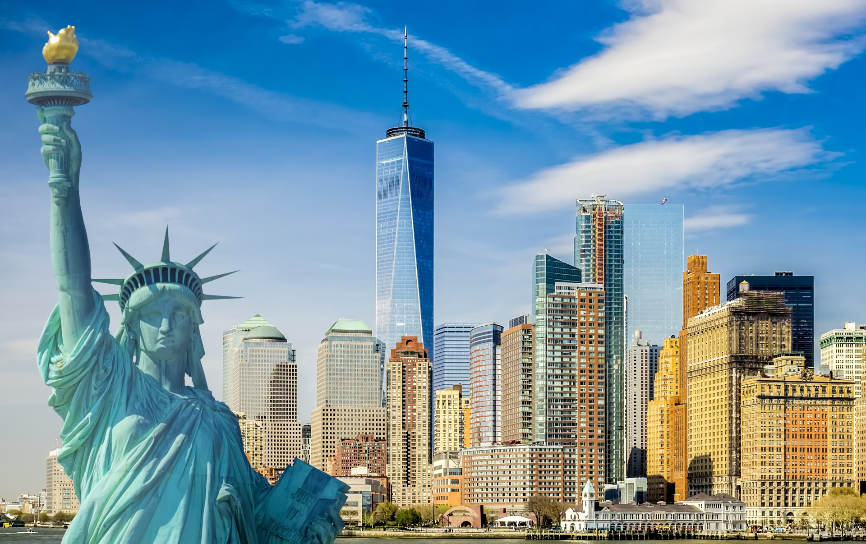
THANKS FOR YOUR ATTETION!
THE END
Made by:Luka Sovulj

