Slide 1
EASTER ISLAND

Slide 2
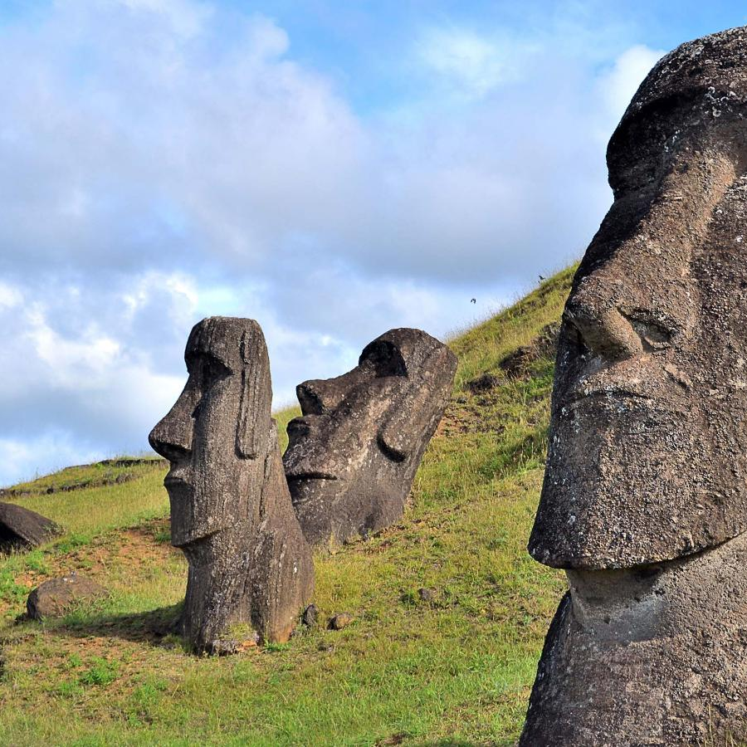
Fun facts
Easter island is a island in Chile,North America.
Area:163.6 km2.
Population 2017: 7,750
In 1995, UNESCO named Easter Island a World Heritage Site.

Slide 3
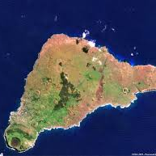
Easter Island is one of the world's most isolated islands.
Easter Island has suffered from heavy soil erosion in recent centuries.
The name "Easter Island" (It is a spanish name) given by the island's first recorded European visitor, the Dutch explorer Jacob Roggeveen, who encountered it on Easter Sunday (5 April) in 1722.
Between 1862 and 1888, about 94% of the population perished or emigrated.

Slide 4
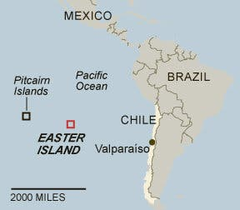
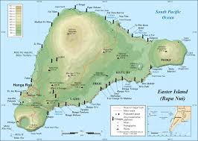
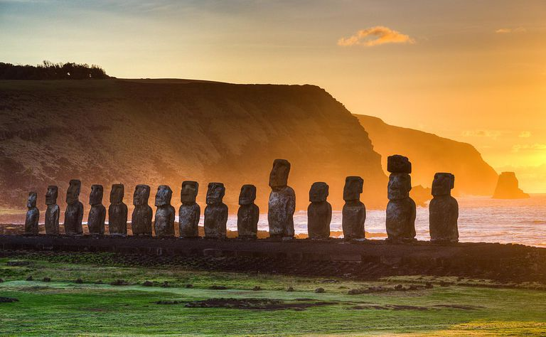
Photo gallery

Slide 5
MADE BY: TONI TOPIĆ THANK YOU FOR THE ATTENCION.

